Slide 1



PEACE, YOUR PERSONAL THERAPIST CHATBOT
A PYTHON SCRIPT FOR A CHATBOT PROVIDING SUPPORT AND GUIDANCE

Slide 2

INTRODUCTION
This Python script implements a chatbot designed to provide support and guidance to users.
The chatbot engages in conversations on various topics, including emotions, mental health, etc.

Slide 3


DEPENDENCIES
Python 3.x, Tkinter
Visual Studio Code

Slide 4
FEATURES OF OUR CHATBOT
Greets the user with a welcome message.
Provides predefined responses based on user-input patterns.
Addresses various topics such as emotions, mental health, etc.
Allows the user to gracefully exit the conversation by typing "bye", and so on.

Slide 5
FUNCTIONS USED
match_response(input_text): Matches user input to predefined patterns and selects a response.
Parameters: input_text (str): The user input text.
Returns: str: A response generated based on the matched pattern.

Slide 6
MAIN LOOP
The script enters a main loop to continuously prompt the user for input.
User input is processed by match_response function to generate a response.
The conversation continues until the user types "bye" to exit.

Slide 7
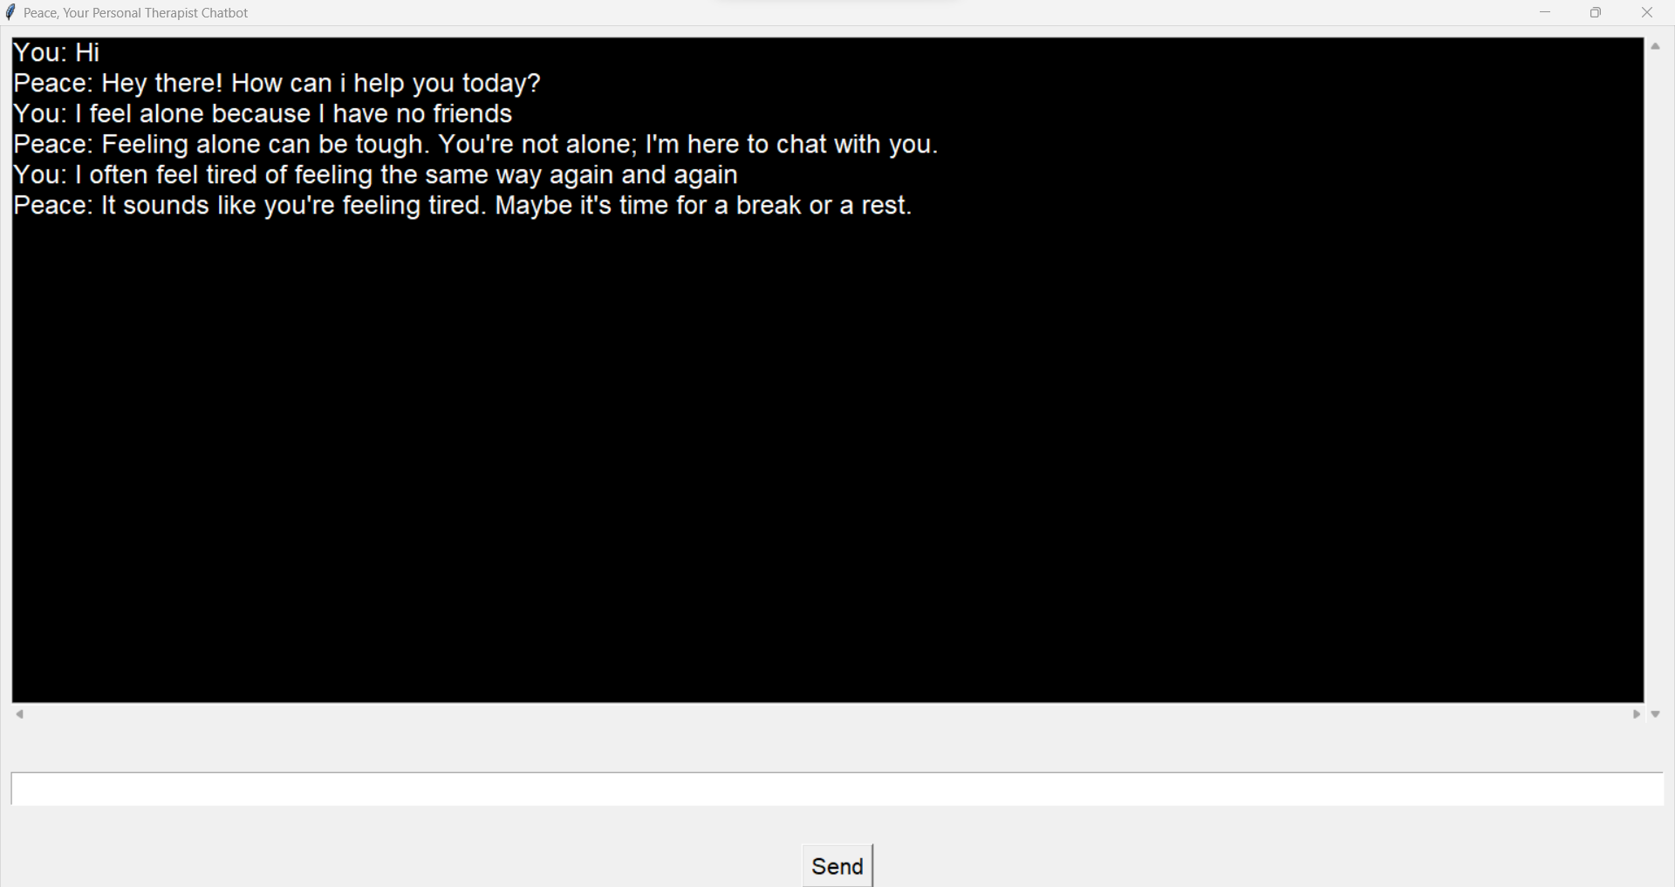
EXAMPLE

Slide 8
CONCLUSION
Accessibility
Versatility
01
02
Our Python script serves as a virtual therapist, providing support and guidance to users who may be experiencing various emotions or seeking advice.
With a wide range of predefined responses, our script can address a variety of user inputs, making it adaptable to different conversation contexts and needs.
User Engagement
Resource Provision
03
04
By offering personalized responses and engaging in interactive dialogue, our script fosters user engagement and encourages open communication.
Our script provides valuable resources and information, such as coping strategies for anxiety, helpline numbers for individuals in distress, enhancing its utility as a supportive tool, etc.
Ease of Use
Continuous Improvement
05
06
With a simple user interface and intuitive interaction flow, our script is easy to use for individuals seeking immediate support or guidance.
We are committed to ongoing development and enhancement of our script, incorporating user feedback and expanding its capabilities to better serve our users.

Slide 9
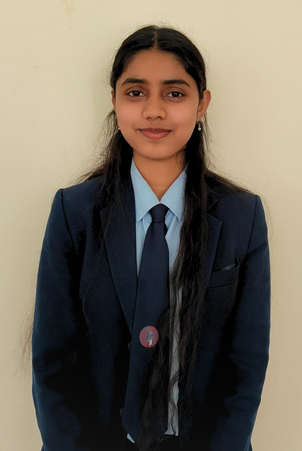
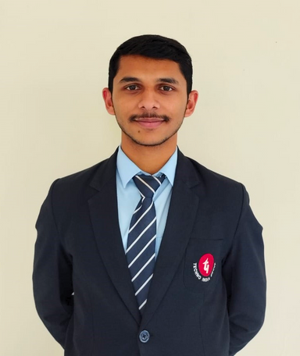
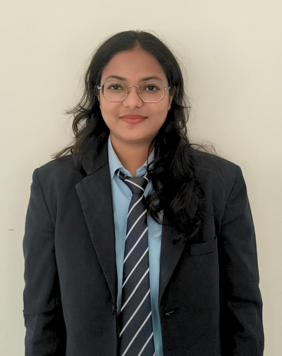
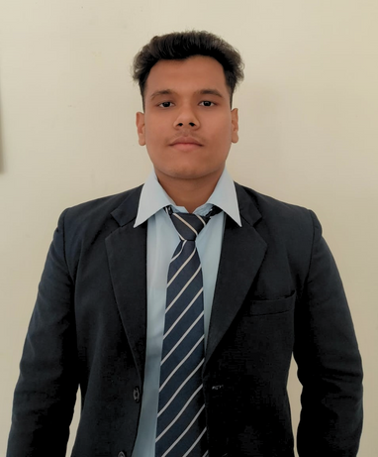




MEET OUR TEAM
Khusi Gupta
Navraj Chettri
Shruti Darshan
Shikhar Sondhiya
Project Manager, Backend Coding, User Experience (UX) Designer
Documentation Specialist, GUI , Content Writer & Overall Development.
Quality Assurance Engineer, Data Specialist.
Software Engineer, Marketing & Outreach Co-ordinator.

Slide 10

CONTACT US
khusigupta2909@gmail.com
chettrinavraj135@gmail.com
darshanshruti02@gmail.com
shikharsondhiya11@gmail.com
Siliguri Institute of Technology, Siliguri.

Slide 11

THANK YOU
THANK YOU FOR JOINING US TODAY!
We appreciate your time and participation.
If you have any questions or feedback, please feel free to reach out.

